Slide 1
Error Detection and Correction
01204325 Data Communications and Computer Networks
Chaiporn Jaikaeo
Department of Computer Engineering Kasetsart University
Based on lecture materials from Data Communications and Networking, 5th ed., Behrouz A. Forouzan, McGraw Hill, 2012.
Revised 2017-10-23

Slide 2
Outline
Types of errors
Redundancy
Coding
Correction vs. detection

Slide 3
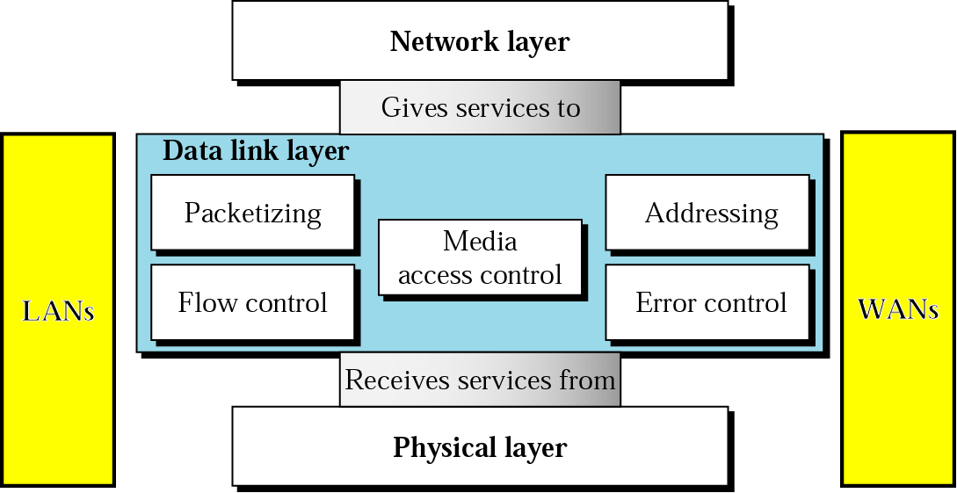
Data Link Layer

Slide 4
Error Control
Detecting errors
Correcting errors
Forward error correction
Automatic repeat request (ARQ)

Slide 5
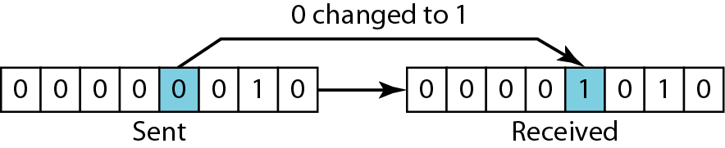
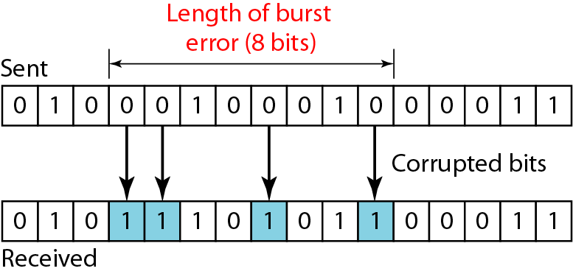
Types of Errors
Single-bit errors
Burst errors

Slide 6
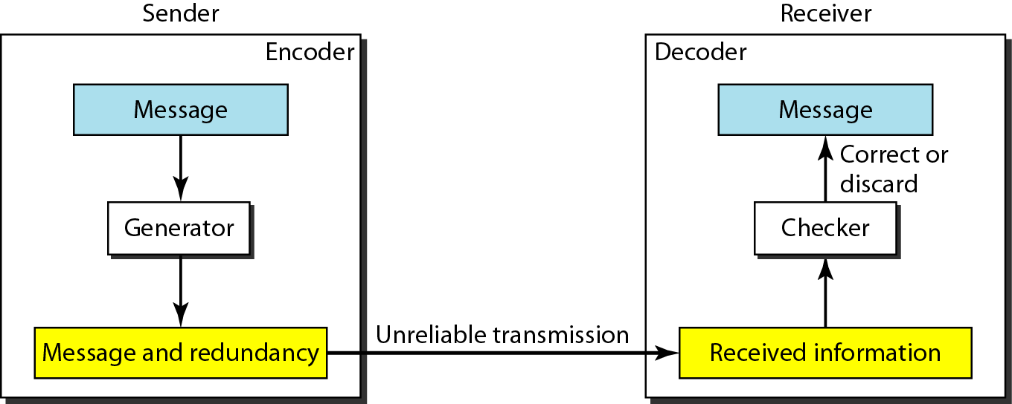
Redundancy
To detect or correct errors, redundant bits of data must be added

Slide 7
Coding
Process of adding redundancy for error detection or correction
Two types:
Block codes
Divides the data to be sent into a set of blocks
Extra information attached to each block
Memoryless
Convolutional codes
Treats data as a series of bits, and computes a code over a continuous series
The code computed for a set of bits depends on the current and previous input

Slide 8
Notes
An error-detecting/correcting code can detect/correct only the types of errors for which it is designed
Other types of errors may remain undetected.
There is no way to detect/correct every possible error!

Slide 9
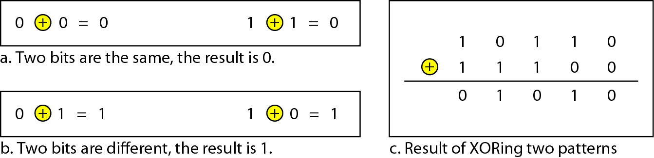
XOR Operation
Main operation for computing error detection/correction codes
Simpler and faster than addition; no carry bit!
Similar to modulo-2 addition

Slide 10
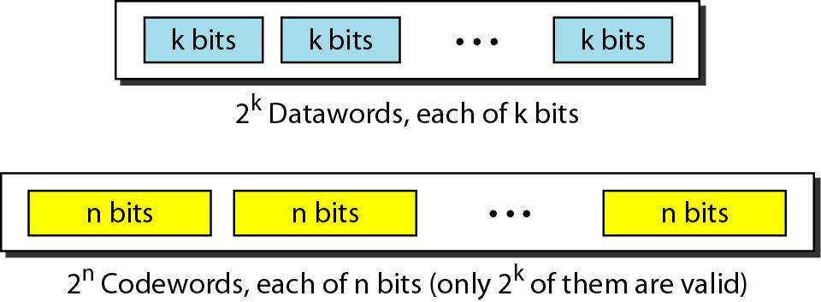
Block Coding
Message is divided into k-bit blocks
Known as datawords
r redundant bits are added
Blocks become n=k+r bits
Known as codewords

Slide 11
Example: 4B/5B Block Coding
Data | Code | Data | Code
0000 | 11110 | 1000 | 10010
0001 | 01001 | 1001 | 10011
0010 | 10100 | 1010 | 10110
0011 | 10101 | 1011 | 10111
0100 | 01010 | 1100 | 11010
0101 | 01011 | 1101 | 11011
0110 | 01110 | 1110 | 11100
0111 | 01111 | 1111 | 11101
k = ?
n = ?
r = ?

Slide 12
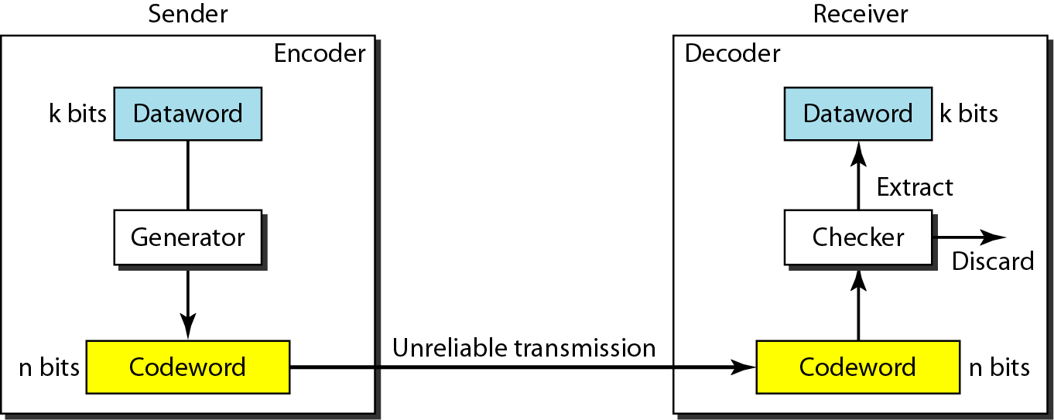
Error Detection in Block Coding

Slide 13
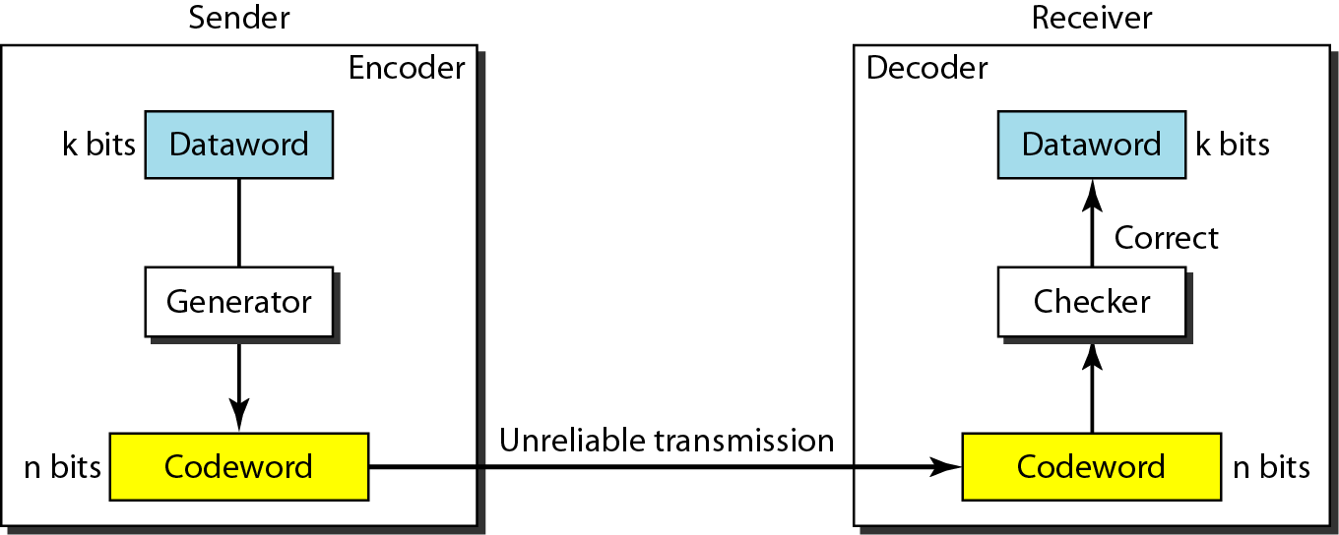
Error Correction in Block Coding

Slide 14
Example: Error Correction Code
Dataword | Codeword
00 | 000
01 | 011
10 | 101
11 | 110
k, n, r = ?
The receiver receives 011, what is the original dataword?
Notes:
Assume the sender encodes the dataword 01 as 011 and sends it to the receiver. Consider the following cases: 1. The receiver receives 011. It is a valid codeword. The receiver extracts the dataword 01 from it. 2. The codeword is corrupted during transmission, and 111 is received (the leftmost bit is corrupted). This is not a valid codeword and is discarded. 3. The codeword is corrupted during transmission, and 000 is received (the right two bits are corrupted). This is a valid codeword. The receiver incorrectly extracts the dataword 00. Two corrupted bits have made the error undetectable.

Slide 15
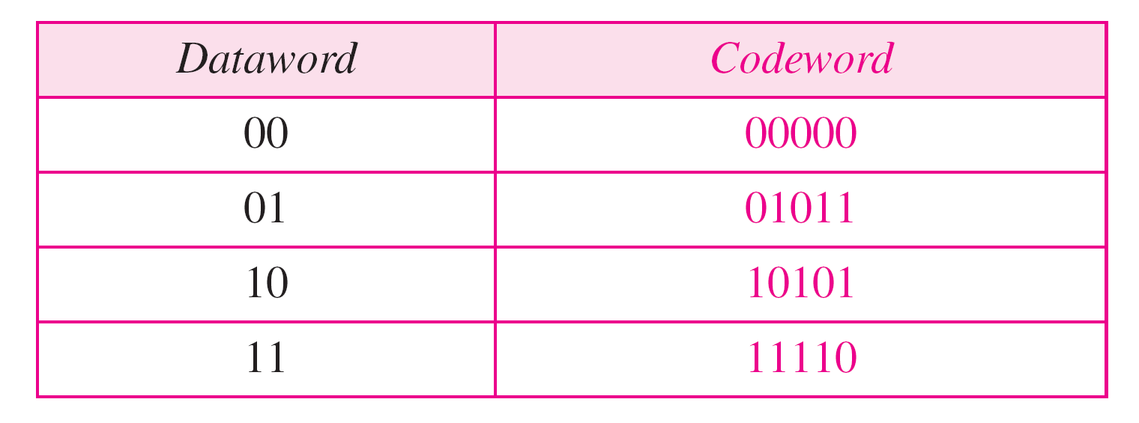
Example: Error Correction Code
k, n, r = ?
The receiver receives 01001, what is the original dataword?

Slide 16
Hamming Distance
Hamming Distance between two words is the number of differences between corresponding bits.
Hamming distance d(000, 011) is 2 because (000 ⊕ 011) is 011 (two 1s).
d(10101, 11110) is 3 because (10101 ⊕ 11110) is 01011 (three 1s).
d(01, 00) = ?
d(11, 00) = ?
d(010, 100) = ?
d(0011, 1000) = ?
How many 8-bit words are n bits away from 10000111?

Slide 17
Minimum Hamming Distance
The minimum Hamming distance is the smallest Hamming distance between all possible pairs in a set of codewords.
Find the minimum Hamming Distance of the following codebook
00000
01011
10101
11110

Slide 18
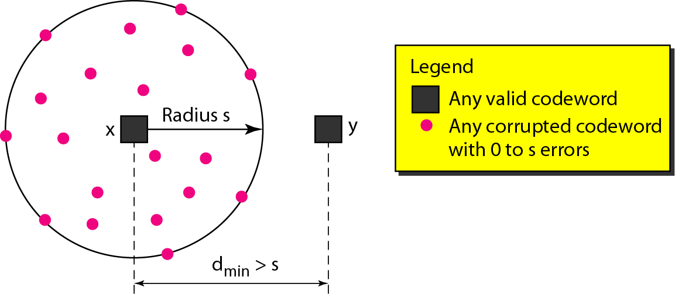
Detection Capability of Code
To guarantee the detection of up to s-bit errors, the minimum Hamming distance in a block code must be
d_{min} = s + 1

Slide 19
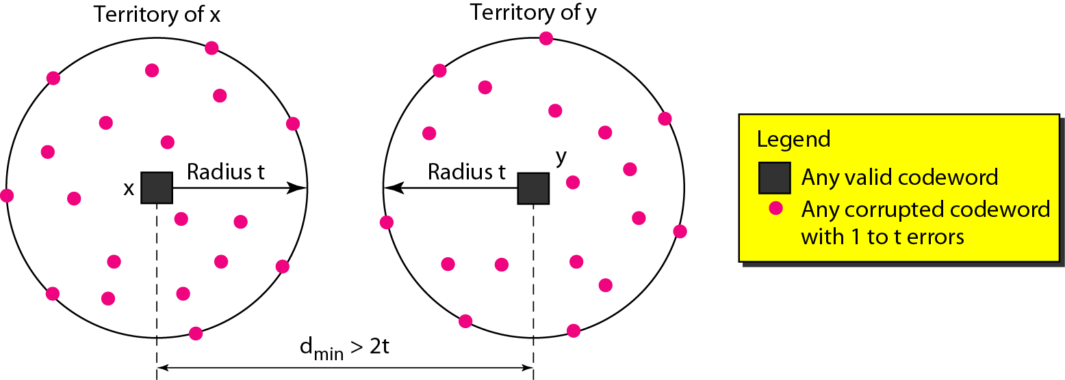
Correction Capability of Code
To guarantee the correction of up to t-bit errors, the minimum Hamming distance in a block code must be
d_{min} = 2t + 1

Slide 20
Example: Hamming Distance
A code scheme has a Hamming distance d_{min} = 4. What is the error detection and correction capability of this scheme?

Slide 21
Common Detection Methods
Parity check
Cyclic Redundancy Check
Checksum

Slide 22
Parity Check
Most common, least complex
Single bit is added to a block
Two schemes:
Even parity – Maintain even number of 1s
E.g., 1011 → 10111
Odd parity – Maintain odd number of 1s
E.g., 1011 → 10110

Slide 23
Example: Parity Check
Suppose the sender wants to send the word world. In ASCII the five characters are coded (with even parity) as
1110111 1101111 1110010 1101100 1100100
The following shows the actual bits sent
11101110 11011110 11100100 11011000 11001001

Slide 24
Example: Parity Check
Receiver receives this sequence of words:
11111110 11011110 11101100 11011000 11001001
Which blocks are accepted? Which are rejected?

Slide 25
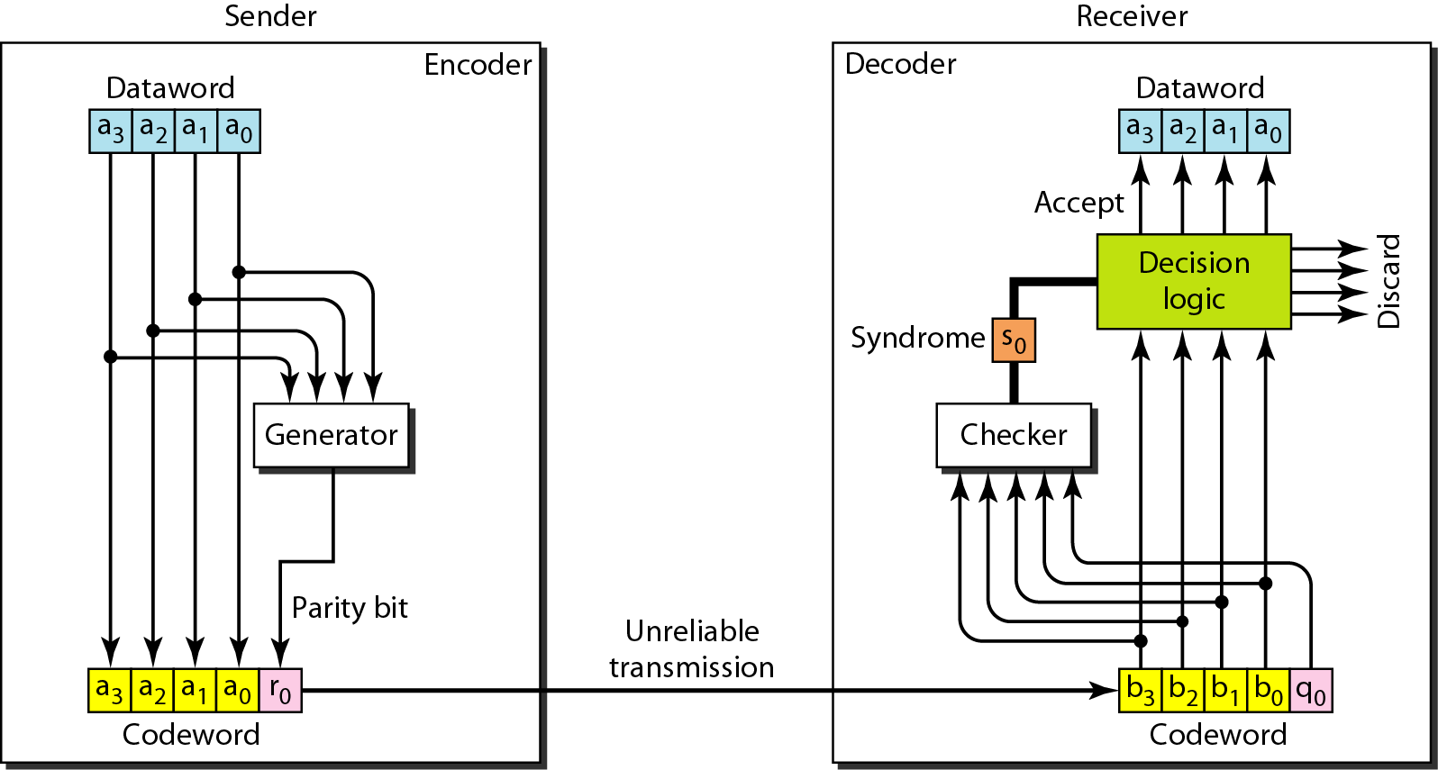
Parity-Check: Encoding/Decoding

Slide 26
Performance of Parity Check
Can 1-bit errors be detected?
Can 2-bit errors be detected?
:

Slide 27
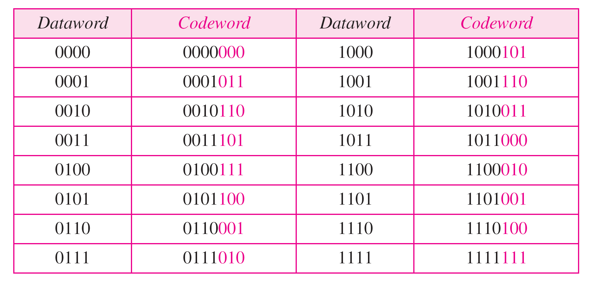
Cyclic Redundancy Check (CRC)
In a cyclic code, rotating a codeword always results in another codeword
Example:

Slide 28
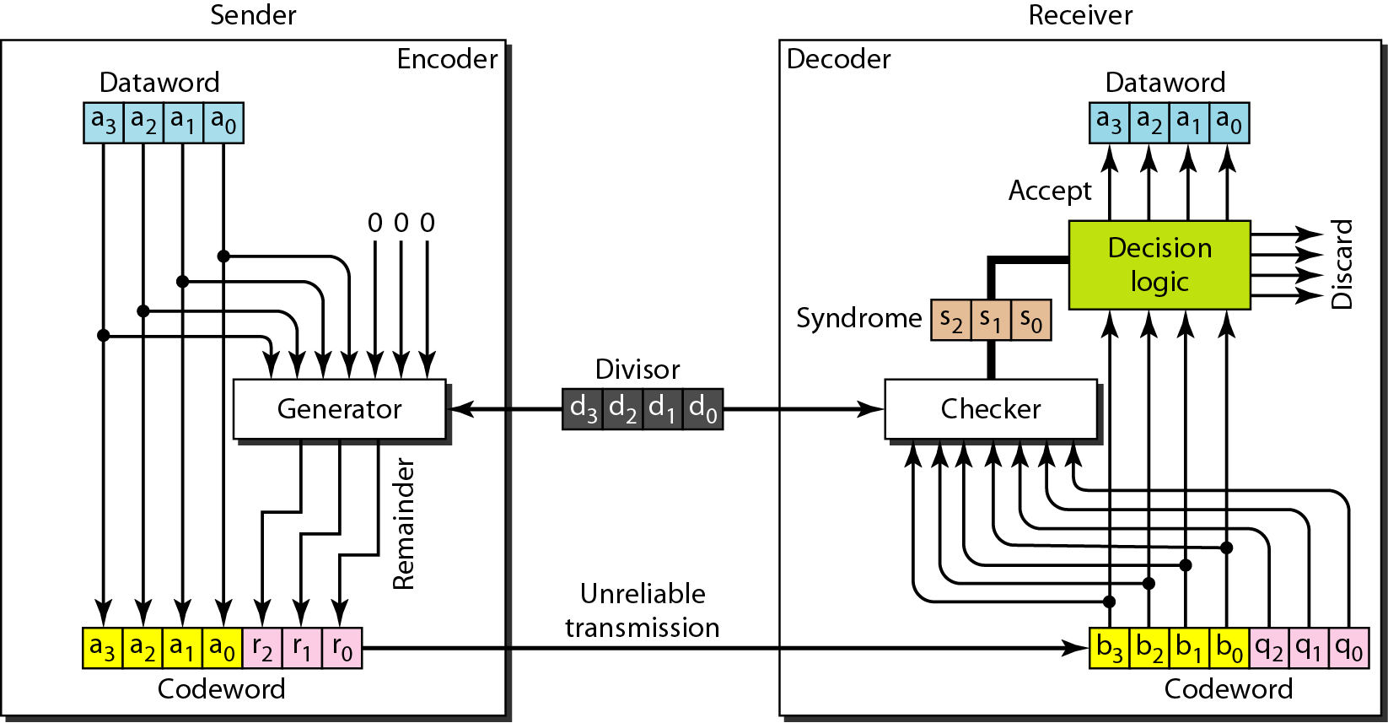
CRC Encoder/Decoder

Slide 29
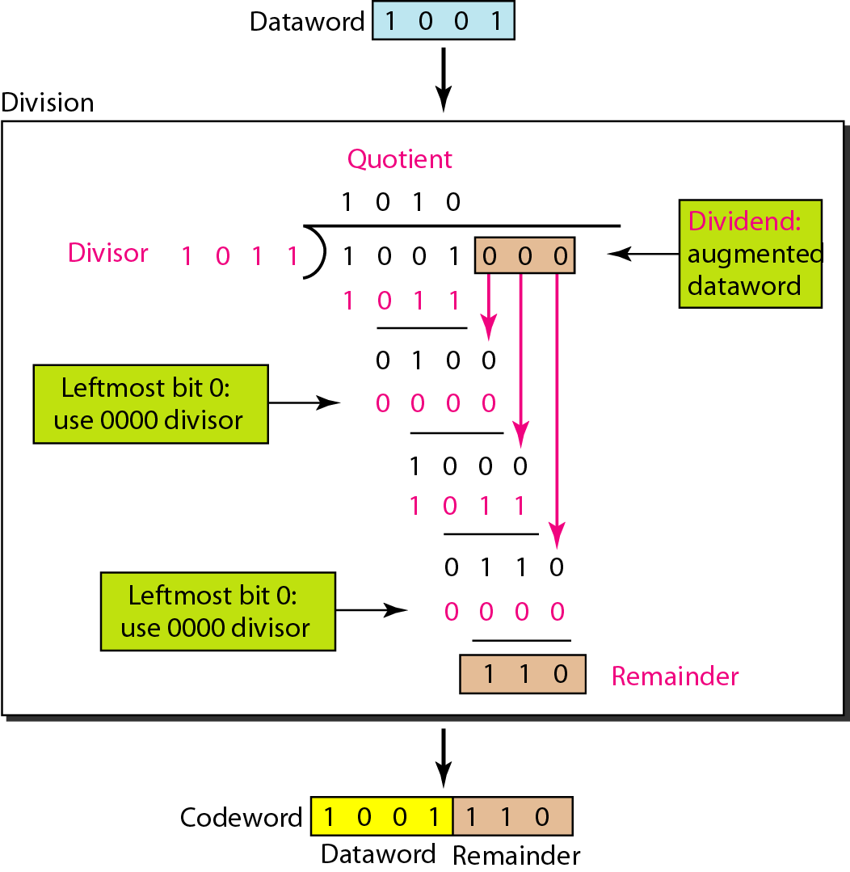
CRC Generator

Slide 30
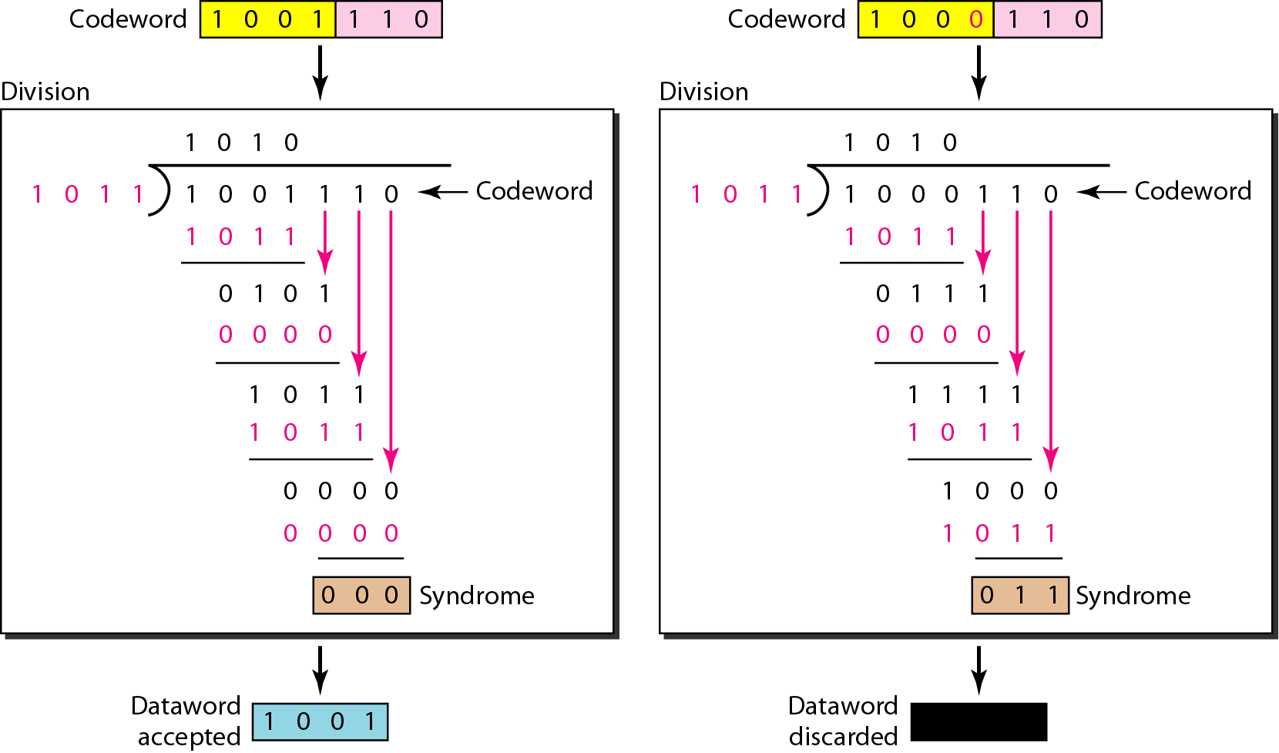
Checking CRC

Slide 31
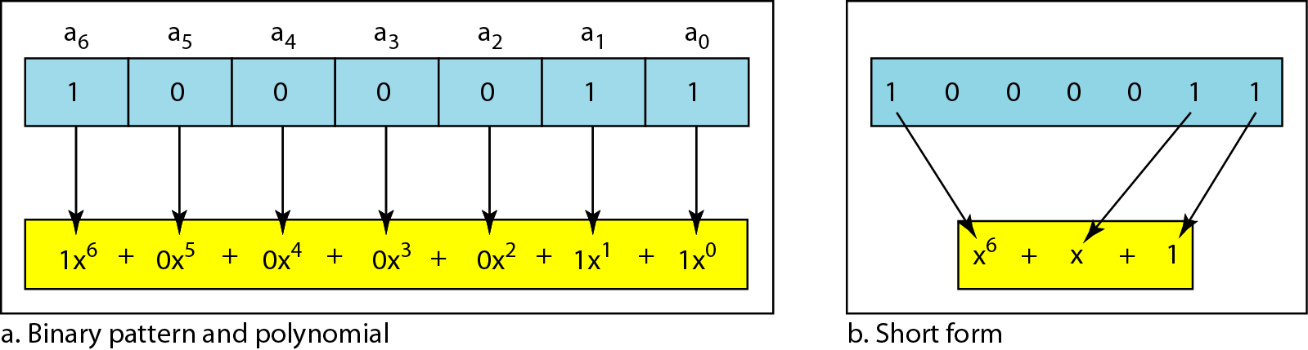
Polynomial Representation
More common representation than binary form
Easy to analyze
Divisor is commonly called generator polynomial

Slide 32
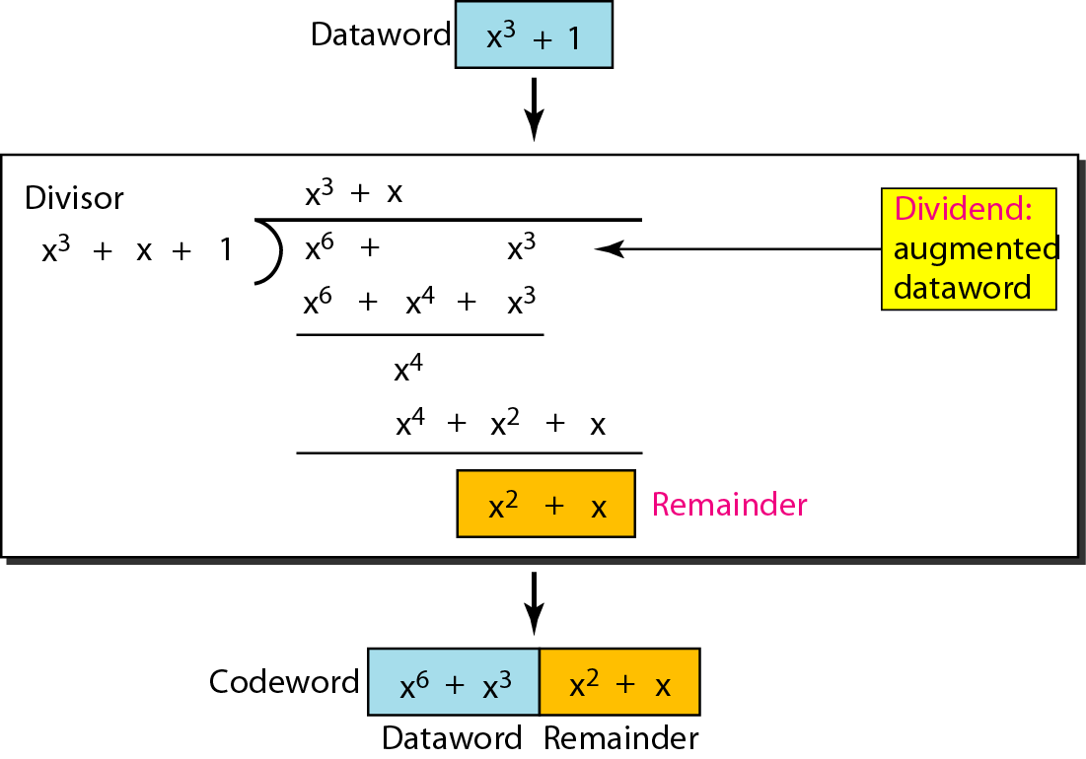
Division Using Polynomial

Slide 33
Strength of CRC
All burst errors with L ≤ n will be detected
All burst errors with L = n + 1 will be detected with probability 1 – (1/2)^{n–1}
All burst errors with L > n + 1 will be detected with probability 1 – (1/2)^{n}

Slide 34
Standard CRC Polynomials

Slide 35
Forward Error Correction (FEC)
Consider only a single-bit error in k bits of data
k possibilities for an error
One possibility for no error
#possibilities = k + 1
Add r redundant bits to distinguish these possibilities; we need
2^{r} ≥ k+1
But the r bits are also transmitted along with data; hence
2^{r} ≥ k+r+1

Slide 36
Redundant Bits
Redundant bits needed for 1-bit FEC
Number of data bits k | Number of redundancy bits r | Total bits k + r
1 | 2 | 3
2 | 3 | 5
3 | 3 | 6
4 | 3 | 7
5 | 4 | 9
6 | 4 | 10
7 | 4 | 11

Slide 37
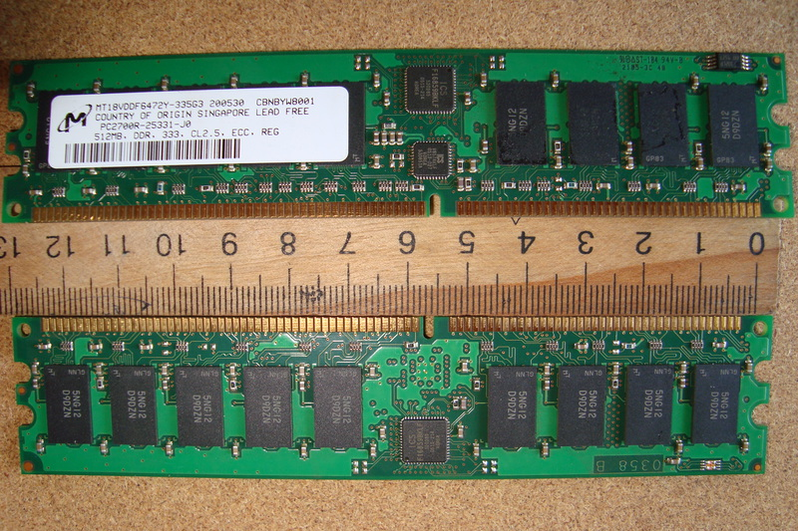
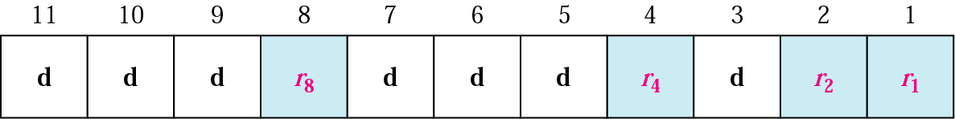
Hamming Code
Simple, powerful FEC
Widely used in computer memory
Known as ECC memory
Source: https://en.wikipedia.org/wiki/ECC_memory
error-correcting bits

Slide 38
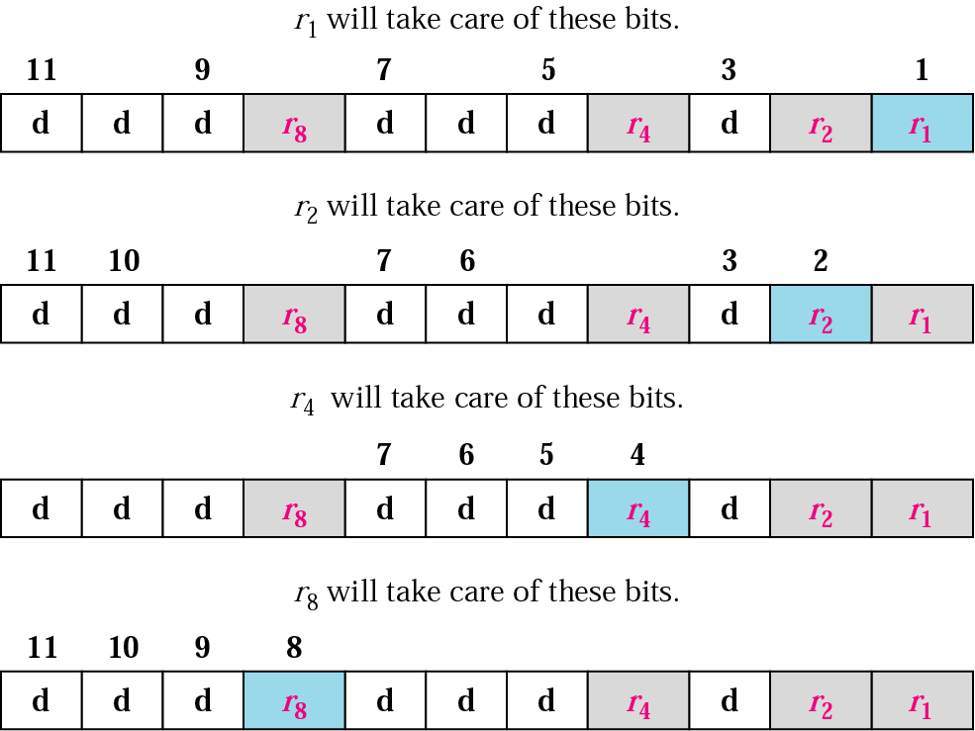
Redundant Bit Calculation

Slide 39
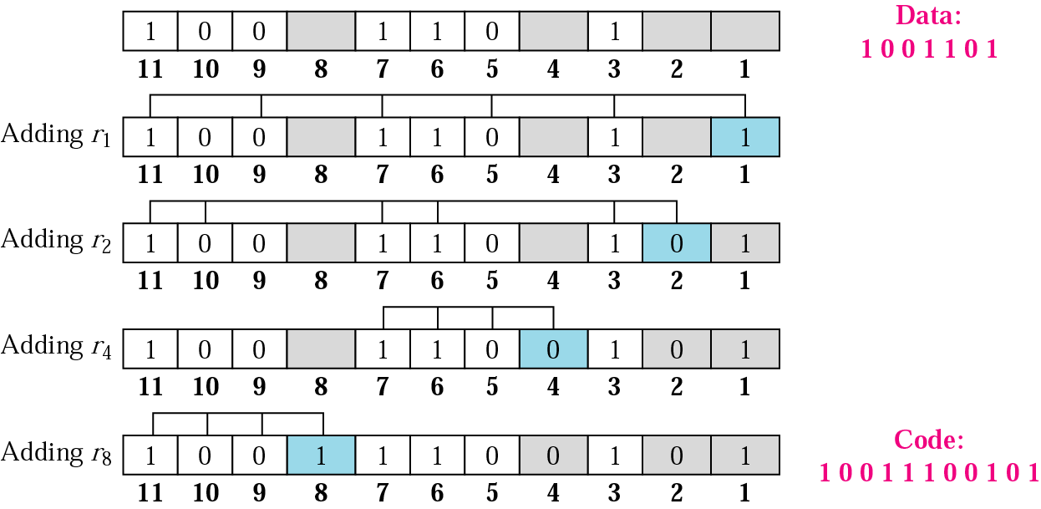
Example: Hamming Code

Slide 40
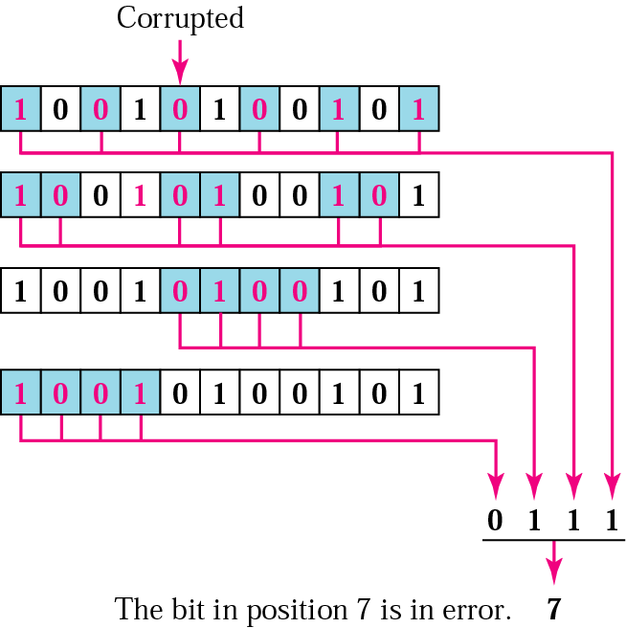
Example: Correcting Error
Receiver receives 10010100101

Slide 41
Strength of Hamming Code
Minimum Hamming Distance is 3
It can correct at most 1 bit error
It can detect at most 2 bit error
But… not both!!! (Why?)
SECDED – Single-Error Correction, Double-Error Detection
Extended Hamming code with one extra parity bit
Achieves minimum Hamming distance of 4
Can distinguish between one bit and two bit errors

Slide 42
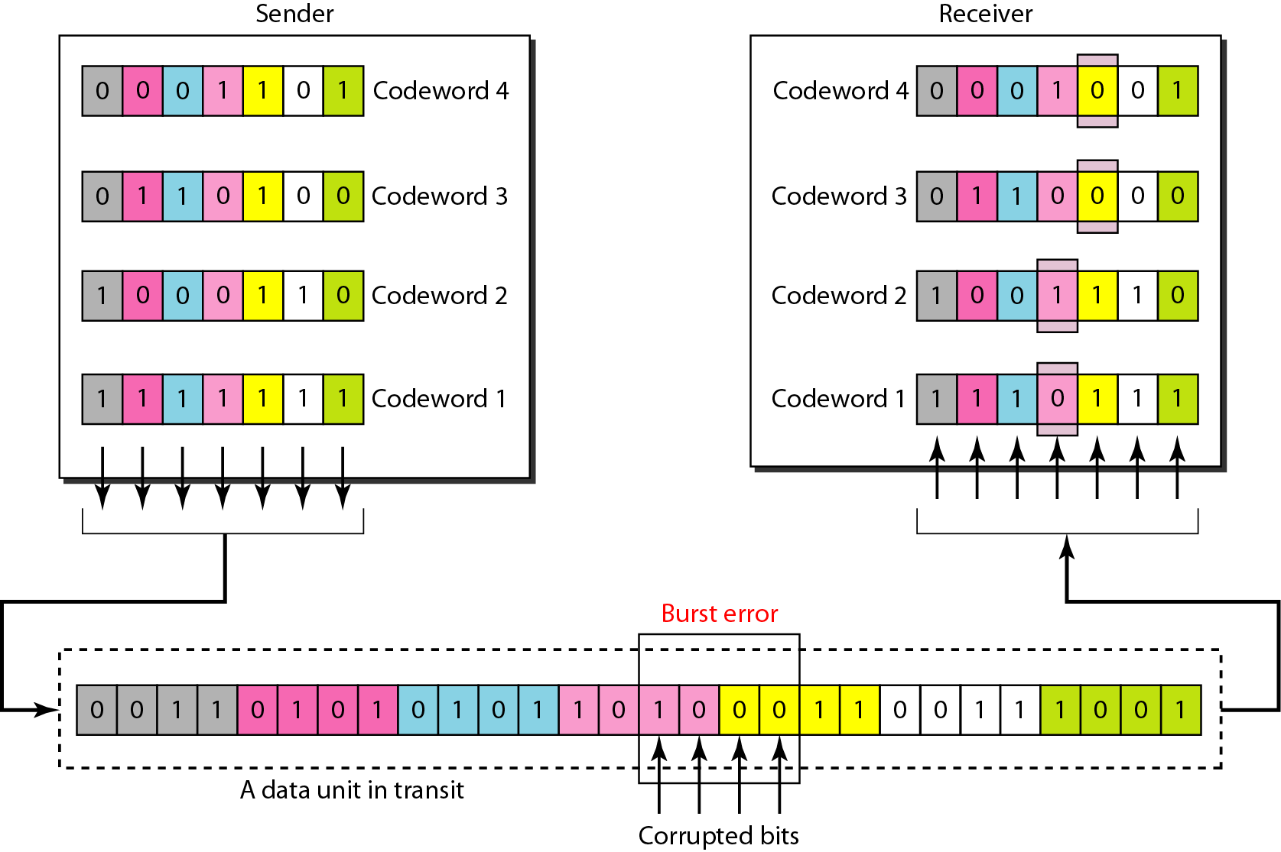
Burst Error Correction

Slide 43
Conclusion
Data can be corrupted during transmission. To detect or correct errors, extra bits (redundancy) must be added to the data
Block coding divides a message into blocks of k bits, called datawords, then maps them to blocks of k+r bits, called codewords
Strength of code is determined by the minimum Hamming distance among its codewords
Parity bits and Cyclic Redundancy Check (CRC) are some common error detection techniques
Hamming code is a simple and powerful error correction code

